Slide 1

E6156 – Cloud Computing:
Backend-as-a-Service
Lecture 8: Some DynamoDB , Additional REST API Concepts (Continued), Lambda Functions Walkthrough, Microservices and SNS, WebHooks, API Gateway
Donald F. Ferguson dff9@Columbia.edu
TRANSCENDING DISCIPLINES, TRANSFORMING LIVES

Slide 2

We will start in a couple of minutes.
2 | E6156 – Cloud Computing: Backend-as-a-Service: Lecture 8

Slide 3
Course Schedule and Assignments Updates
3 | E6156 – Cloud Computing: Backend-as-a-Service: Lecture 8

Slide 4
Course Schedule (Tentative)
Date | Topics | Milestones
30-OCT | Microservices and Events, SNS, Webhooks, Lambda Function Walkthrough API Gateway Some additional REST concepts
6-NOV | Security concepts, middleware, OAuth 2 CloudFront, DNS, HTTPS, Certificates
13-NOV | Workflow, orchestration, Step Functions ETags, conditional updates, asynchronous operations, message middleware
20-NOV | Caching, Redis, Elasticache CloudSearch
27-NOV | Thanksgiving Break
4-DEC | GraphQL Google Docs integration
11-DEC | Overflow Project reviews begin
18-DEC | Project reviews complete.
Milestone 3
Milestone 4
If there are concepts that interest you but are not on the list, please let me know.
Milestone 5

Slide 5
Additional REST API Concept
5 | E6156 – Cloud Computing: Backend-as-a-Service: Lecture 8

Slide 6
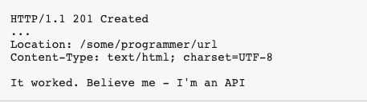
POST/CREATED and Links
A core element of the URL pattern is:
/resource_collection – Is like an RDB table and supports POST, GET with query, ...
/resource_collection/some_id – Is like a row in a table identified by the primary key value.
How does the application “know” the primary key of a resource is creates in a collection?
There are many types of primary key.
“A natural key is a single column or set of columns that uniquely identifies a single record in a table, ... ...”
In this case, I could “just know” how to use the columns of what I created to form the URL.
If names were unique, then
POST {“last_name”: “Ferguson”, “first_name”: “Donald”, “iq”: 50} to /people
Would produce a resource /people/Ferguson_Donald
But, this is not HATEOAS; I have external knowledge on the key formation algorithm.
What if the key is a surrogate that the service creates when creating the resource, e.g. UNI. The client has no way to know what the ID is.
POST returns “201 CREATED” and a Link header to the created resource.
This will be a requirement for you microservices.
6 | E6156 – Cloud Computing: Backend-as-a-Service: Lecture 8 © Donald Ferguson, 2020

Slide 7
CAP Theorem, Consistency
DynamoDB
7 | E6156 – Cloud Computing: Backend-as-a-Service: Lecture 8

Slide 8
CAP Theorem
Consistency
Every read receives the most recent write or an error.
Availability
Every request receives a (non-error) response – without guarantee that it contains the most recent write.
Partition Tolerance
The system continues to operate despite an arbitrary number of messages being dropped (or delayed) by the network between nodes
8 | E6156 – Cloud Computing: Backend-as-a-Service: Lecture 8 © Donald Ferguson, 2020

Slide 9
Availability and Consistency Requires Connected
There are two basic patterns
Active/Passive
All requests go to master during normal processing.
Updates are transactionally queued for processing at passive backup.
Failure of master
Routes subsequent requests to backup.
Backup must process and commit updates before accepting requests.
Active/Active
Both environments process requests.
Some form of distributed transaction commit required to synchronize updates on both copies.
Multi-system communication to guarantee consistency is the foundation for tradeoffs in CAP.
The system can be CAP if and only iff
There are never any partitions or system failures
Which is unrealistic in cloud/Internet systems.
9 | E6156 – Cloud Computing: Backend-as-a-Service: Lecture 8 © Donald Ferguson, 2020

Slide 10
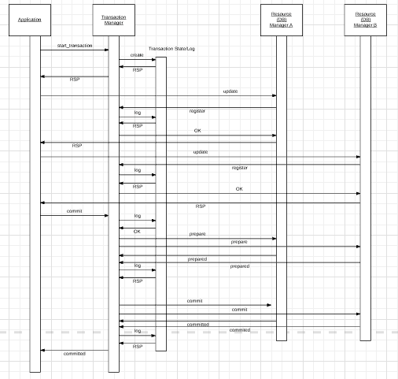
Availability and Consistency Requires Connected
“In transaction processing, databases, and computer networking, the two-phase commit protocol (2PC) is a type of atomic commitment protocol (ACP). It is a distributed algorithm that coordinates all the processes that participate in a distributed atomic transaction on whether to commit or abort (roll back) the transaction (it is a specialized type of consensus protocol). The protocol achieves its goal even in many cases of temporary system failure (involving either process, network node, communication, etc. failures), and is thus widely used” (www.wikipedia.org)
Note: This sequence diagram omits some steps.
Uses:
ACID, especially consistency, for data in different databases/services.
Modified approach is required to strictly achieve consistency and availability for replicated data,
10 | E6156 – Cloud Computing: Backend-as-a-Service: Lecture 8 © Donald Ferguson, 2020

Slide 11
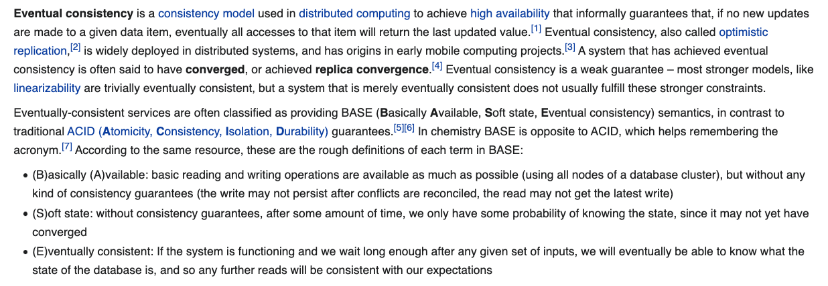
Eventual Consistency
The preceding two slides were simplistic overviews of some of the concepts.
If the DB tolerates network partitions, the DB must either: return error or potentially out of date values.
Achieving availability → you must have multiple copies of the data.
Consistency requires some form of distributed synchronization for updates → cannot tolerate partitions.
Availability and partition tolerance → cannot synchronize updates.
For a lot of applications,
You do not need ACID properties
You cannot achieve the massive, required scale and achieve ACID properties.
All of this is an overly simplistic explanation of some pretty complex concepts and alternatives.
11 | E6156 – Cloud Computing: Backend-as-a-Service: Lecture 8 © Donald Ferguson, 2020

Slide 12
Eventual Consistency
Availability and scalability via
Multiple, replicated data stores.
Read goes to “any” replica.
PUT/POST/DELETE
Goes to any replica
Change propagate asynchronously
GET may not see the latest value if the update has not propagated to the replica.
There are several algorithms for conflict resolution
Detect and handle in application.
Clock/change vectors/version numbers
… …
get
put

Slide 13
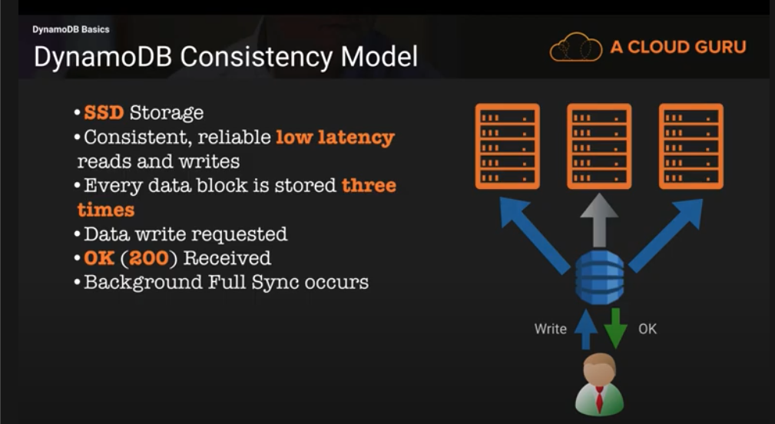
DynamoDB Model

Slide 14
Conditional Write
Suppose I want to write a a comment, only if it has not changed since I read it.
The structure of my comments is:
comment_id
comment
datetime
email
responses []
tags []
version_id
I can do a conditional write.
Update the data in the field comment, or some other field if and only if.
The version_id has not changed.
And provide a new version_id.

Slide 15
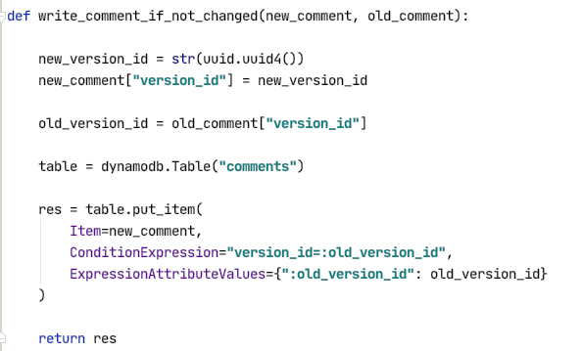
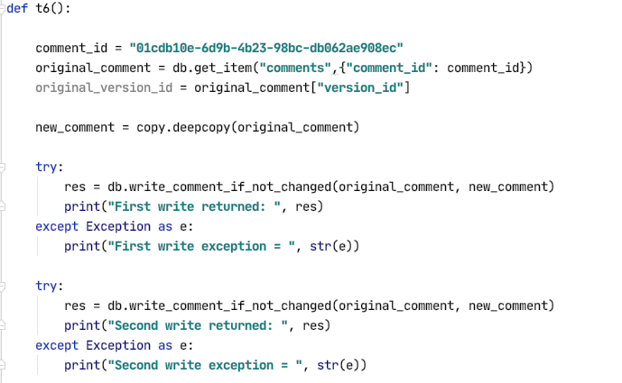
Conditional Write -- Example

Slide 16
Function-as-a-Service Lambda Functions
16 | E6156 – Cloud Computing: Backend-as-a-Service

Slide 17
Terminology and Definitions Stolen from theWeb
Serverless computing is a cloud computing execution model in which the cloud provider runs the server, and dynamically manages the allocation of machine resources. Pricing is based on the actual amount of resources consumed by an application, rather than on pre-purchased units of capacity.^{[1]} It can be a form of utility computing. Serverless computing can simplify the process of deploying code into production. Scaling, capacity planning and maintenance operations may be hidden from the developer or operator. Serverless code can be used in conjunction with code deployed in traditional styles, such as microservices. Alternatively, applications can be written to be purely serverless and use no provisioned servers at all.^{[2]} This should not be confused with computing or networking models that do not require an actual server to function, such as peer-to-peer (P2P).”
Function as a service (FaaS) is a category of cloud computing services that provides a platform allowing customers to develop, run, and manage application functionalities without the complexity of building and maintaining the infrastructure typically associated with developing and launching an app.^{[1]} Building an application following this model is one way of achieving a "serverless" architecture, and is typically used when building microservices applications.”
That was baffling:
IaaS, CaaS – You control the SW stack and the cloud provides (virtual) HW.
PaaS – The cloud hides the lower layer SW and provides an application container (e.g. Flask) with “Your code goes here.” You are aware of container.
FaaS – The cloud provides the container, and you implement functions (corresponding to routes in REST).
17 | E6156 – Cloud Computing: Backend-as-a-Service (Lecture 6)

Slide 18
Serverless/Function-as-a-Service
https://medium.com/@tanmayct/serverless-architecture-function-as-a-service-19e127b8c990
18 | E6156 – Cloud Computing: Backend-as-a-Service (Lecture 6)

Slide 19









What is Serverless good for?
Serverless is good for
short-running
stateless
event-driven
Serverless is not good for
long-running
stateful
number crunching
Microservices
Databases
Mobile Backends
Deep Learning Training
Bots, ML Inferencing
Heavy-Duty Stream Analytics
IoT
f(x)
Numerical Simulation
Modest Stream Processing
Video Streaming
Service integration
https://www.serverlesscomputing.org/wosc3/presentations/intro.pptx

Slide 20
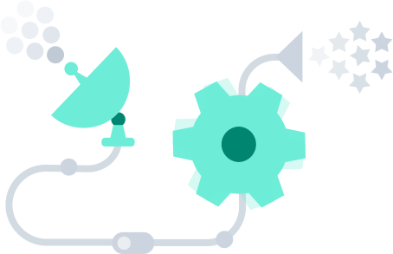
What triggers code execution?
Runs code in response to events
Event-programming model
Notes:
What is Serverless

Slide 21
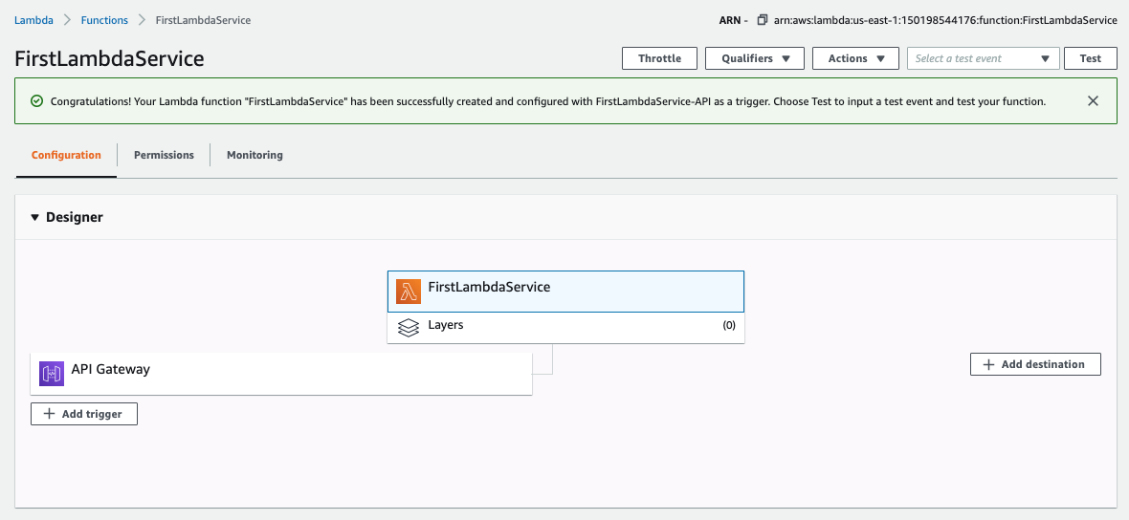
Lambda Function
21 | E6156: Topics in SW Engineering – Cloud Computing/BaaS

Slide 22
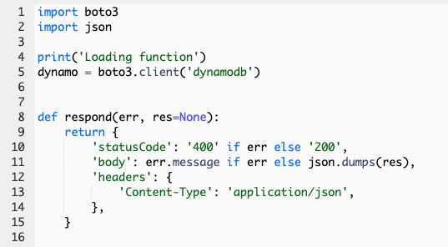
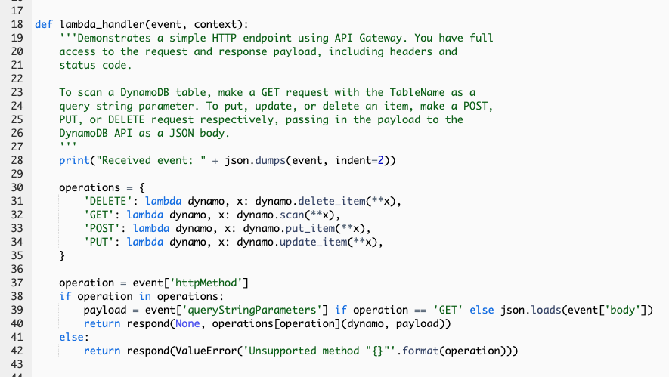
Lambda Function
22 | E6156: Topics in SW Engineering – Cloud Computing/BaaS

Slide 23
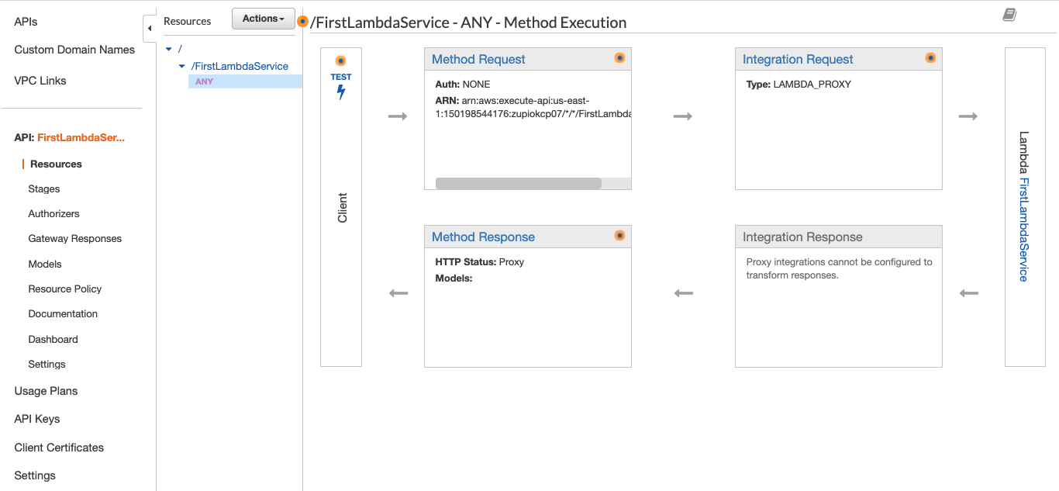
API Gateway Event
23 | E6156: Topics in SW Engineering – Cloud Computing/BaaS

Slide 24
Demo/Samples
Let’s take it for a spin.
24 | E6156 – Cloud Computing: Backend-as-a-Service (Lecture 6)

Slide 25
Pub/Sub
25 | E6156 – Cloud Computing: Backend-as-a-Service

Slide 26
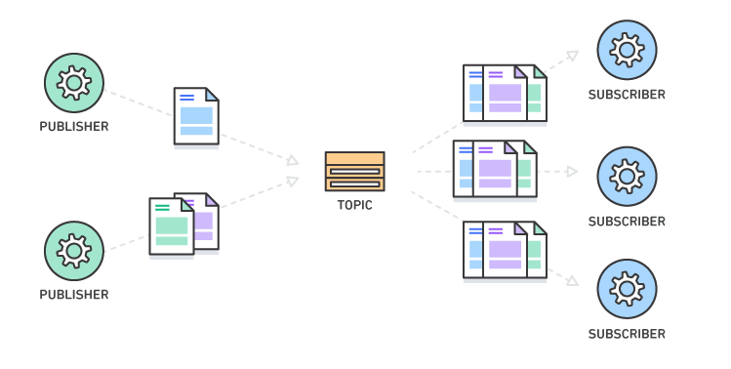
Pub/Sub – Event Driven Processing
“In software architecture, publish–subscribe is a messaging pattern where senders of messages, called publishers, do not program the messages to be sent directly to specific receivers, called subscribers, but instead categorize published messages into classes without knowledge of which subscribers, if any, there may be. Similarly, subscribers express interest in one or more classes and only receive messages that are of interest, without knowledge of which publishers, if any, there are.
Publish–subscribe is a sibling of the message queue paradigm, and is typically one part of a larger message-oriented middleware system. Most messaging systems support both the pub/sub and message queue models in their API, e.g. Java Message Service (JMS).
This pattern provides greater network scalability and a more dynamic network topology, with a resulting decreased flexibility to modify the publisher and the structure of the published data.”
It also support loose coupling for application evolution and agility.
I can add and evolve services without modifying the services.
https://en.wikipedia.org/wiki/Publish%E2%80%93subscribe_pattern
26 | E6156: Topics in SW Engineering – Cloud Computing/BaaS

Slide 27
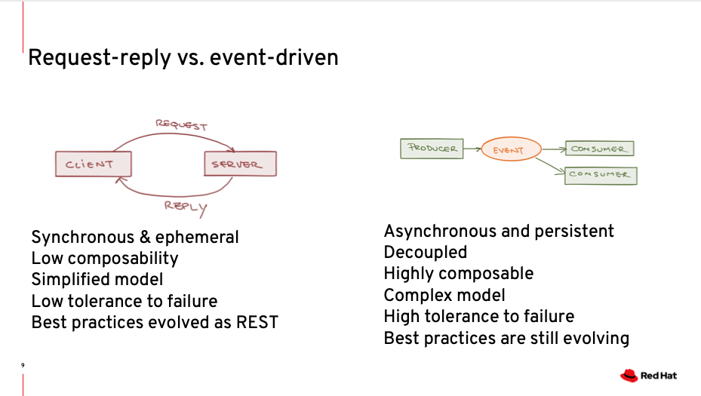
Pub/Sub – Event Driven Processing
https://www.slideshare.net/marius_bogoevici/event-driven-microservices-in-the-serverless-age
27 | E6156: Topics in SW Engineering – Cloud Computing/BaaS

Slide 28
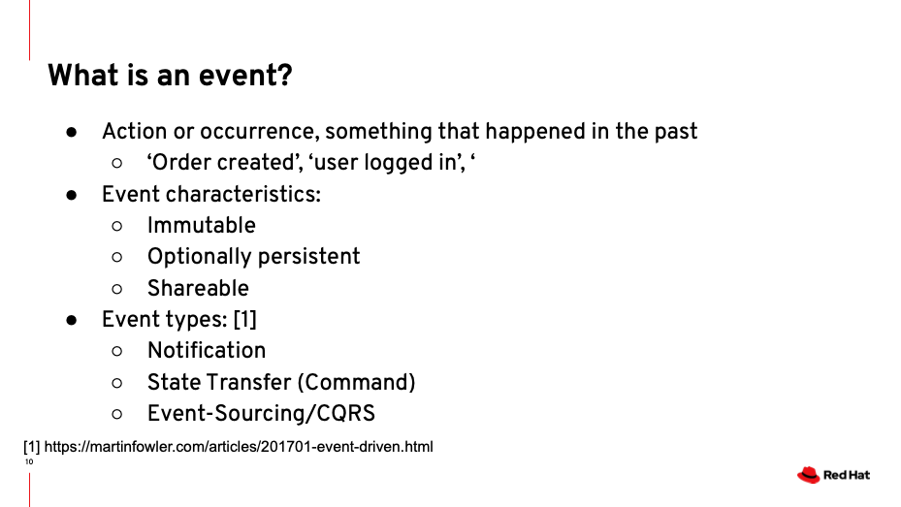
Pub/Sub – Event Driven Processing
https://www.slideshare.net/marius_bogoevici/event-driven-microservices-in-the-serverless-age
28 | E6156: Topics in SW Engineering – Cloud Computing/BaaS

Slide 29
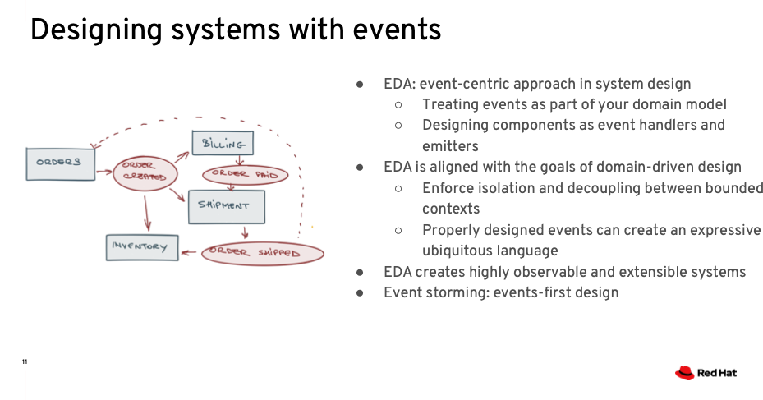
Pub/Sub – Event Driven Processing
https://www.slideshare.net/marius_bogoevici/event-driven-microservices-in-the-serverless-age
29 | E6156: Topics in SW Engineering – Cloud Computing/BaaS

Slide 30
Pub/Sub – Simple Notification Service
30 | E6156: Topics in SW Engineering – Cloud Computing/BaaS

Slide 31
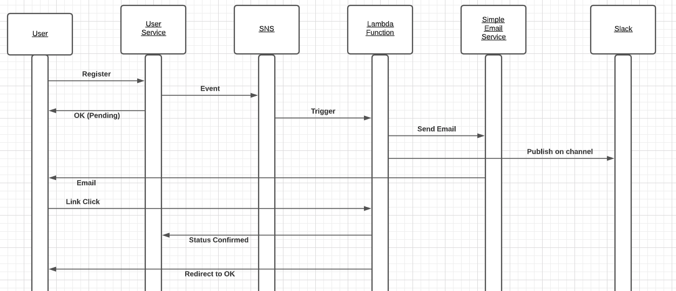
Scenario – Email ID Verification
Requires defining a Slack Webhook
Users provide email IDs when registering with the overall application.
Account is pending until email ownership verified.
User receives and email with activation link. Clicking on link changes account state to active.
Some, e.g. interested business person, sees notification on a Slack channel.
31 | E6156: Topics in SW Engineering – Cloud Computing/BaaS

Slide 32
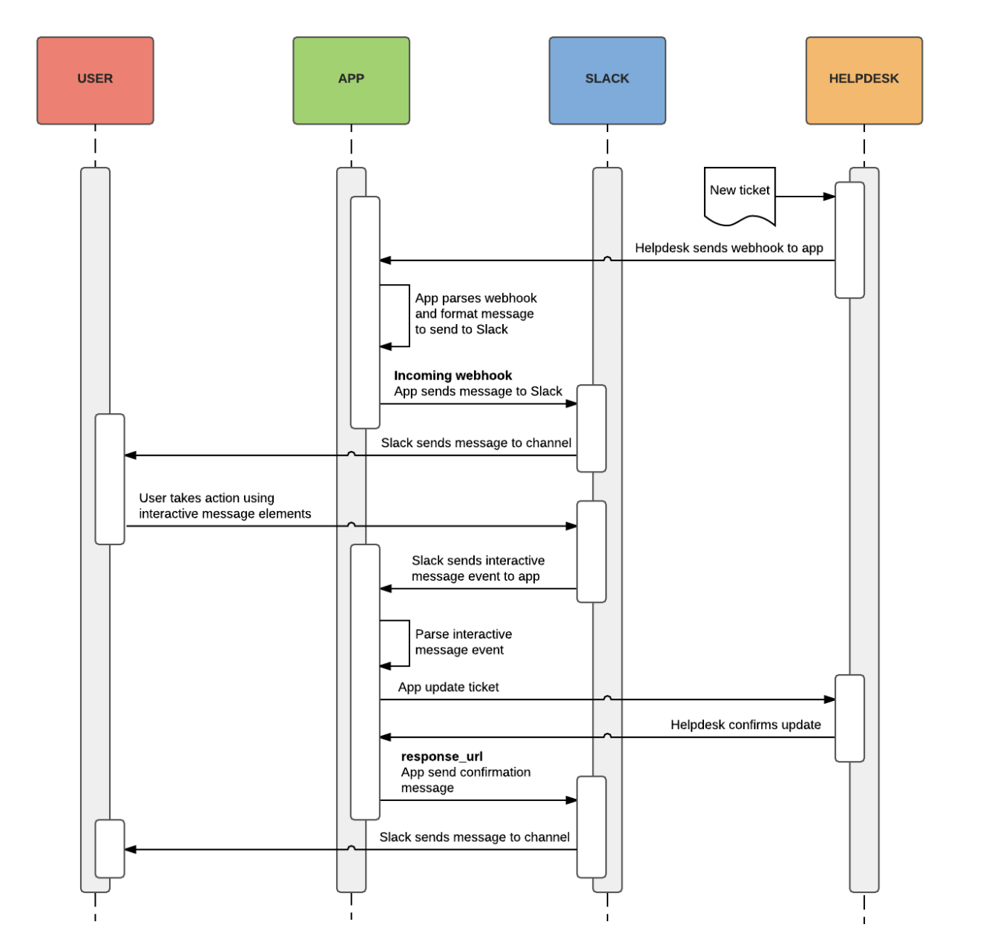
Webhooks
General concept:
“A webhook in web development is a method of augmenting or altering the behavior of a web page or web application with custom callbacks. These callbacks may be maintained, modified, and managed by third-party users and developers who may not necessarily be affiliated with the originating website or application.” (https://en.wikipedia.org/wiki/Webhook)
Webhooks allow user notification or triggering operations at site T when something interesting happens on site S. The semantics of what “is interesting” depends on sites and applications.
Slack provides some examples, including a help desk scenario. (https://api.slack.com/best-practices/blueprints/actionable-notifications)
Many sites APIs support Webhooks.
32 | E6156: Topics in SW Engineering – Cloud Computing/BaaS

Slide 33
Demo/Samples
Let’s take it for a spin. Lambda function.
Emphasize importance of using secret for update → User Service.
Walkthrough of WebHooks.
33 | E6156 – Cloud Computing: Backend-as-a-Service (Lecture 6)

Slide 34
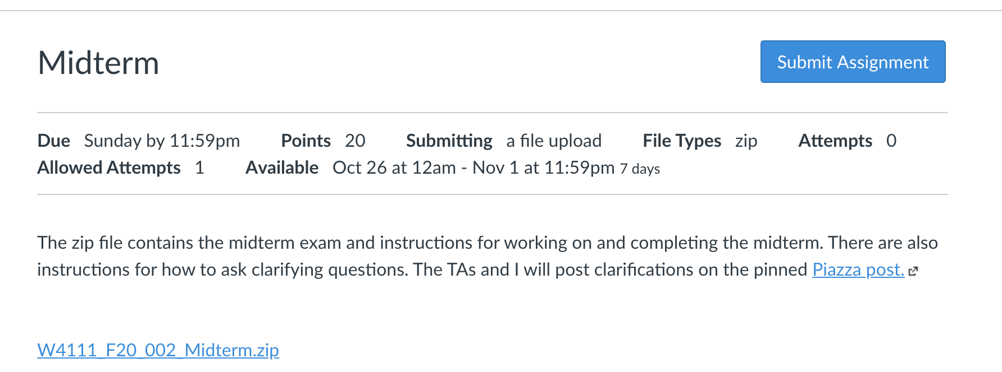
Student view of Midterm Assignment on CourseWorks.

